Slide 1
Machine Learning Final Project
Ivan Liu

Slide 2

Introduction
Seoul Bike Sharing Demand
A regression problem
one-year data, recorded hourly
8,760 observation, 14 features
Photo on Red Dot Org.

Slide 3
Feature Information
Date : year-month-day
Rented Bike count – Count of bikes rented at each hour
Hour - Hour of the day
Temperature - Temperature in Celsius
Humidity - %
Windspeed - m/s
Visibility - 10m
Dew point temperature - Celsius
Solar radiation - MJ/m2
Rainfall - mm
Snowfall - cm
Seasons - Winter, Spring, Summer, Autumn
Holiday - Holiday/No holiday
Functional Day – NoFunc(Non Functional Hours), Fun(Functional hours)

Slide 4
Steps
EDA
(Exploratory
Data
Analysis)
Data
Data Cleaning
Feature
Engineering
Machine
Learning
Prediction
Error
Hyperparameter Tuning

Slide 5
EDA (Exploratory Data Analysis)
Let’s explore the dataset!

Slide 6
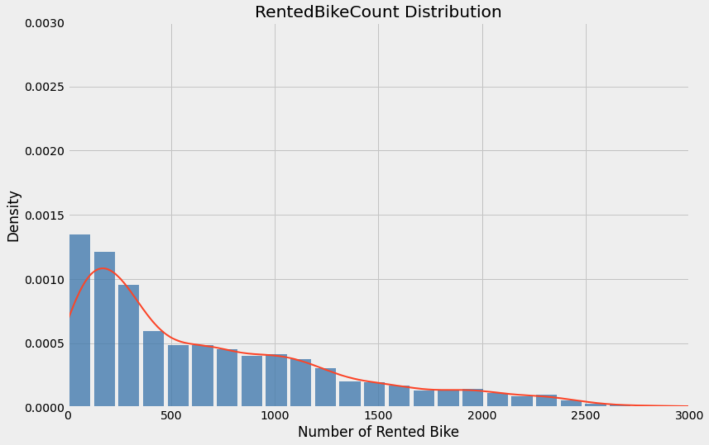

Slide 7
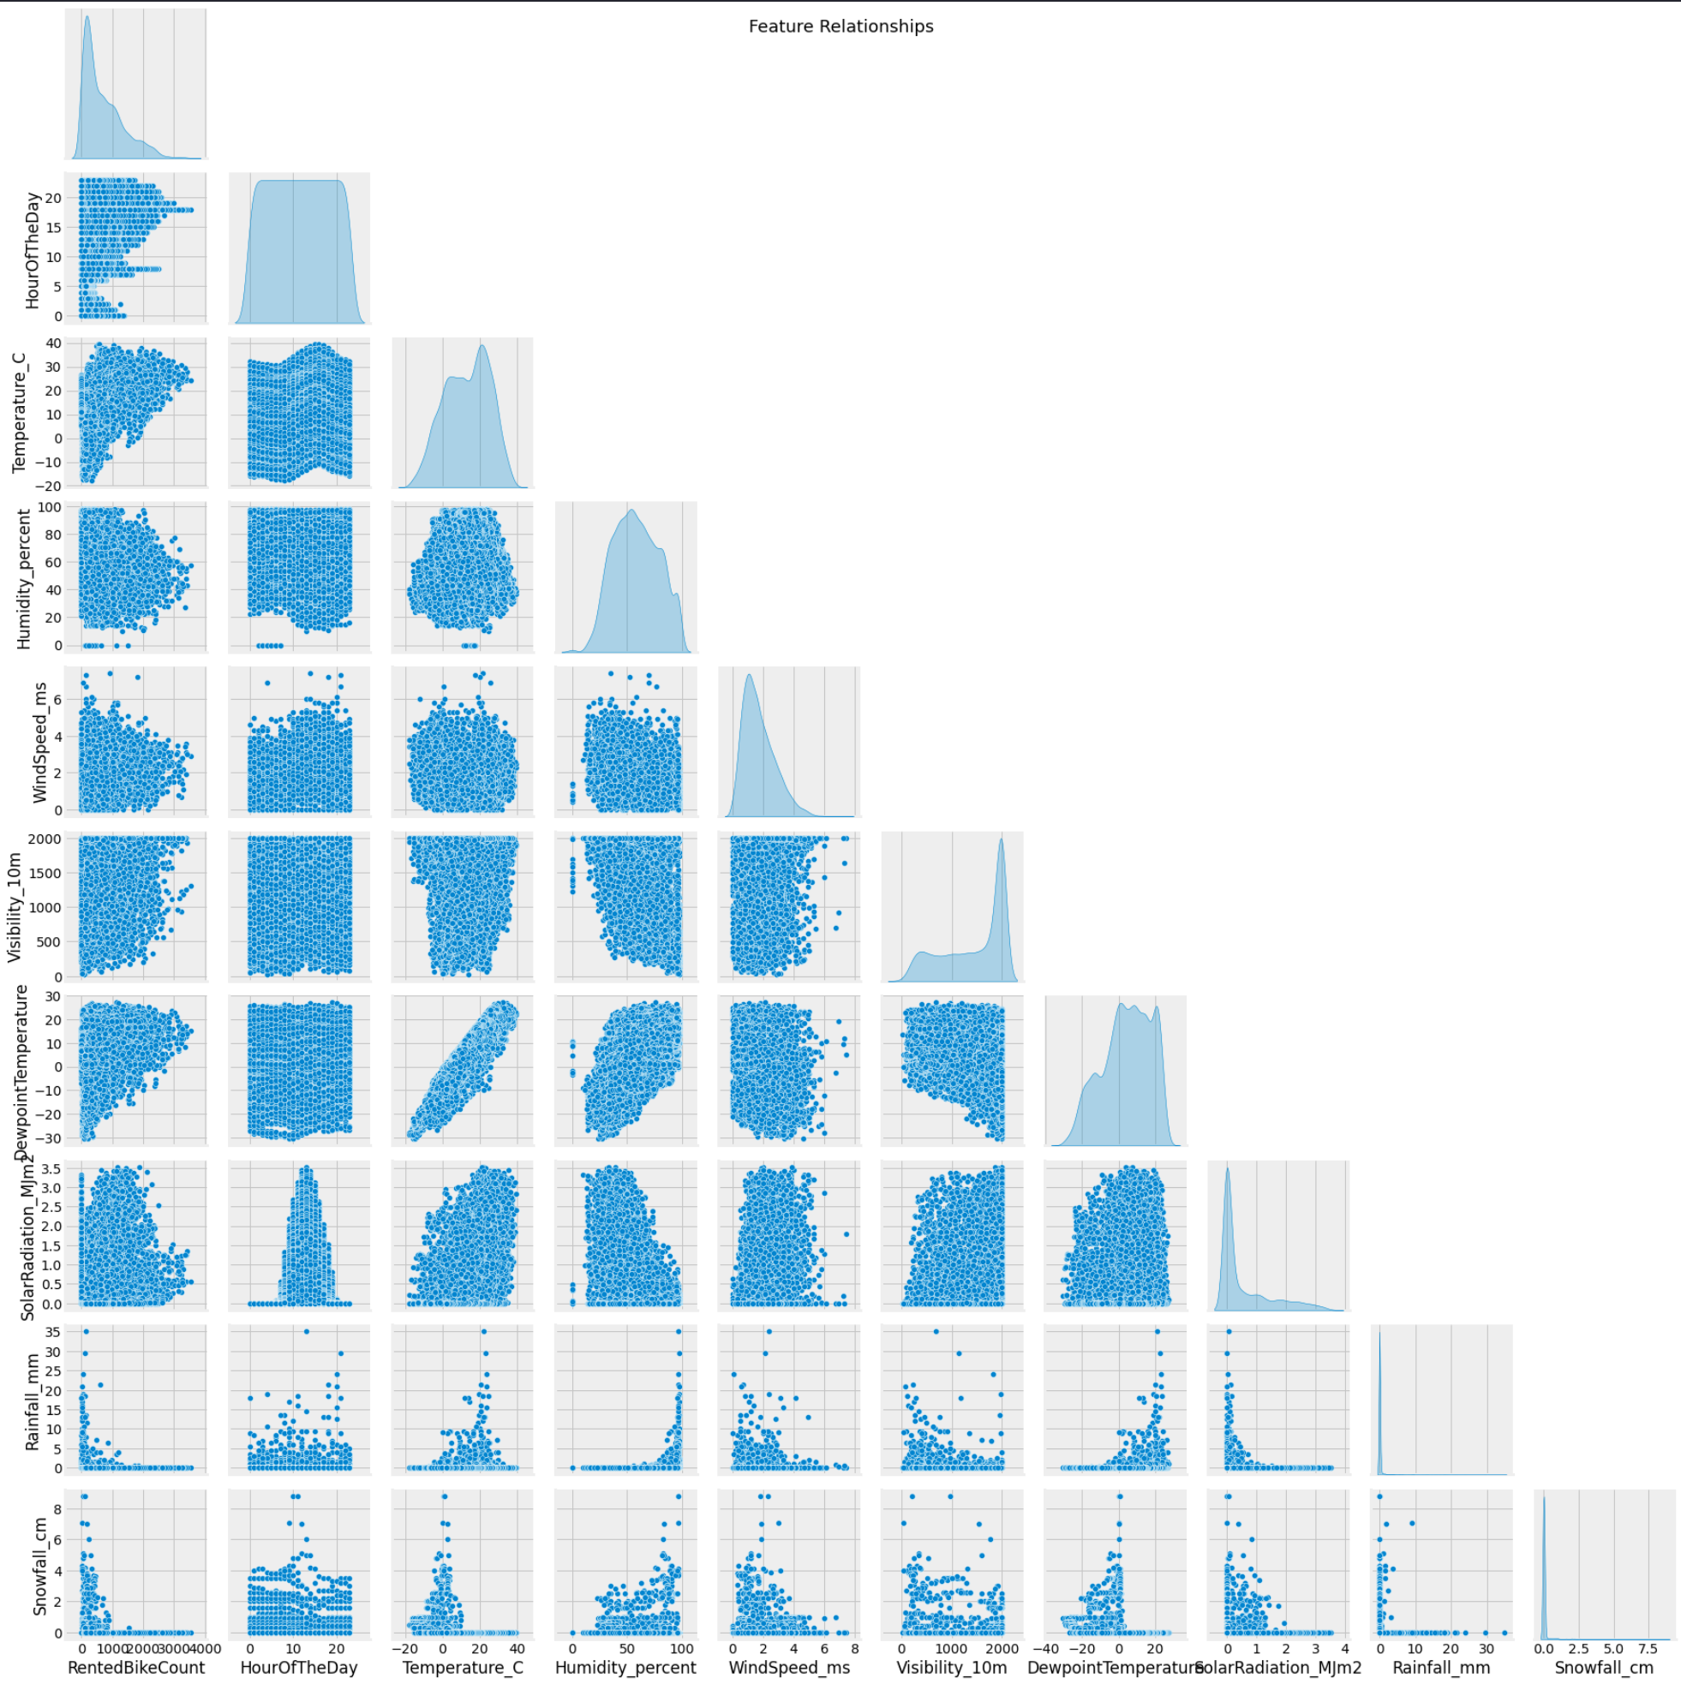
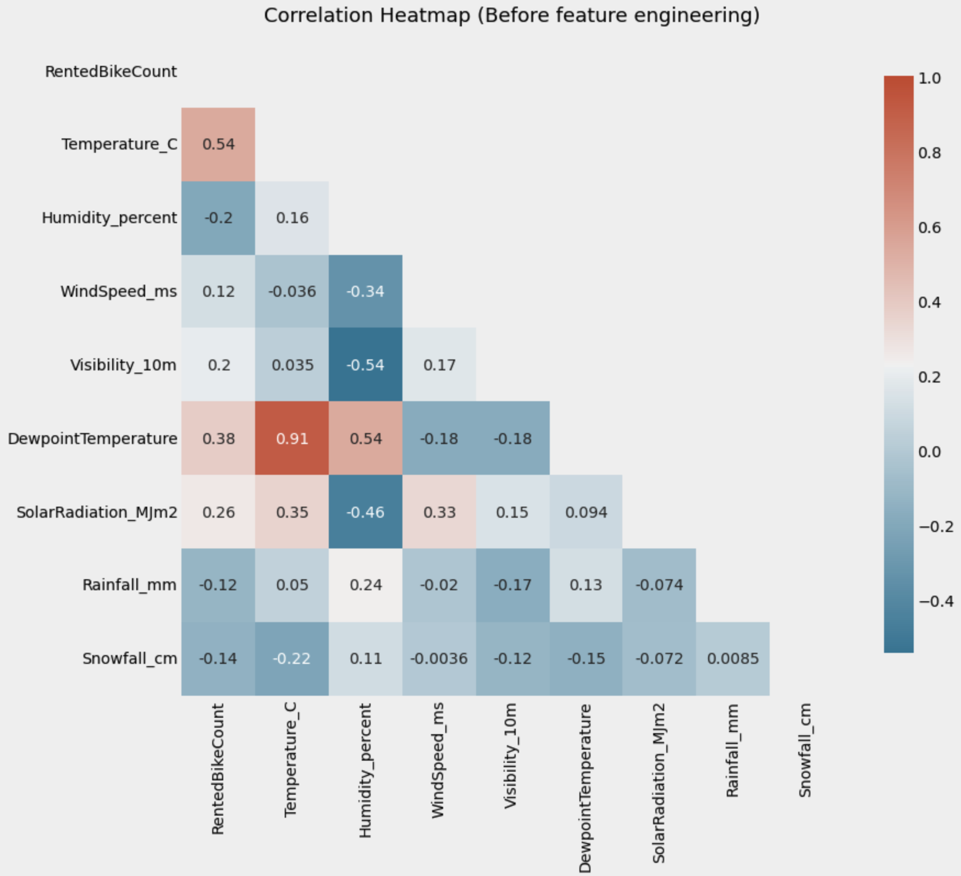

Slide 8
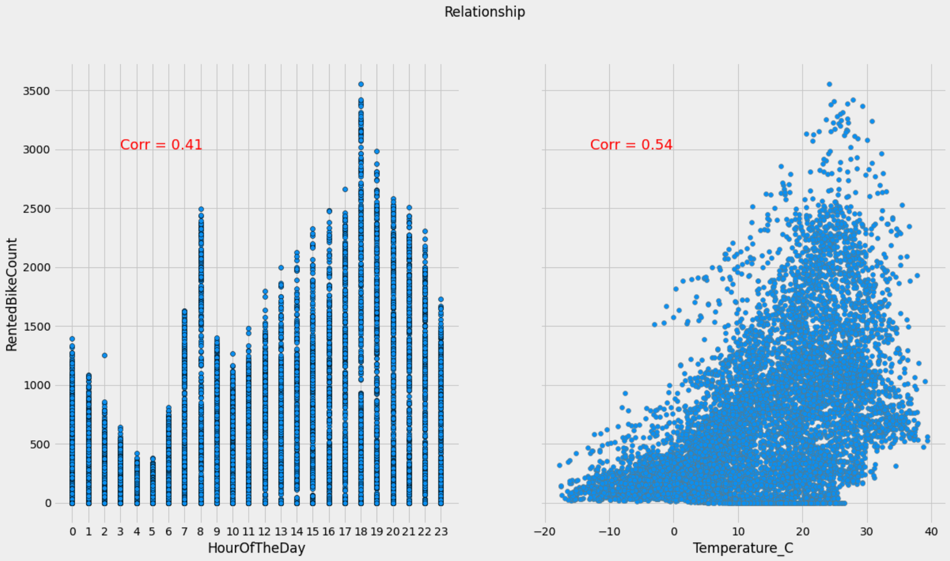

Slide 9
Categorical Features
the purpose of renting bikes
Holiday | Holiday | No Holiday
Functioning Day
No | 24 | 271
Yes | 408 | 8057

Slide 10
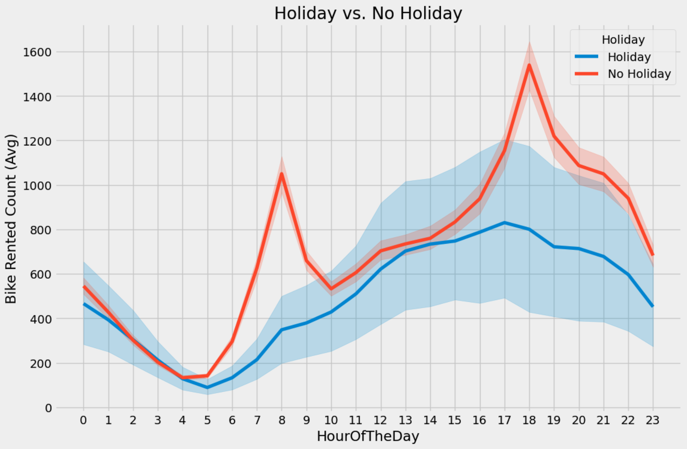

Slide 11
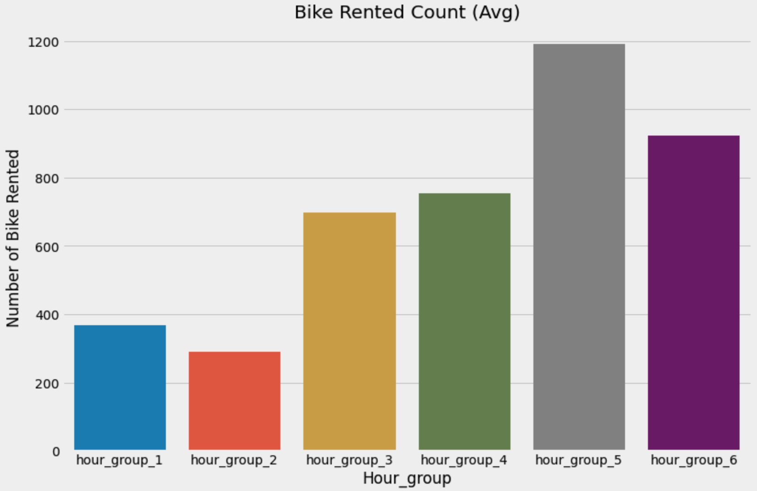
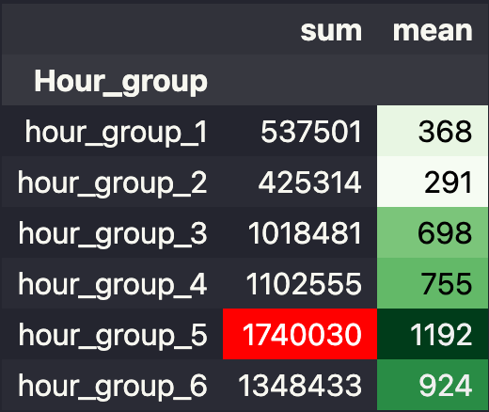

Slide 12
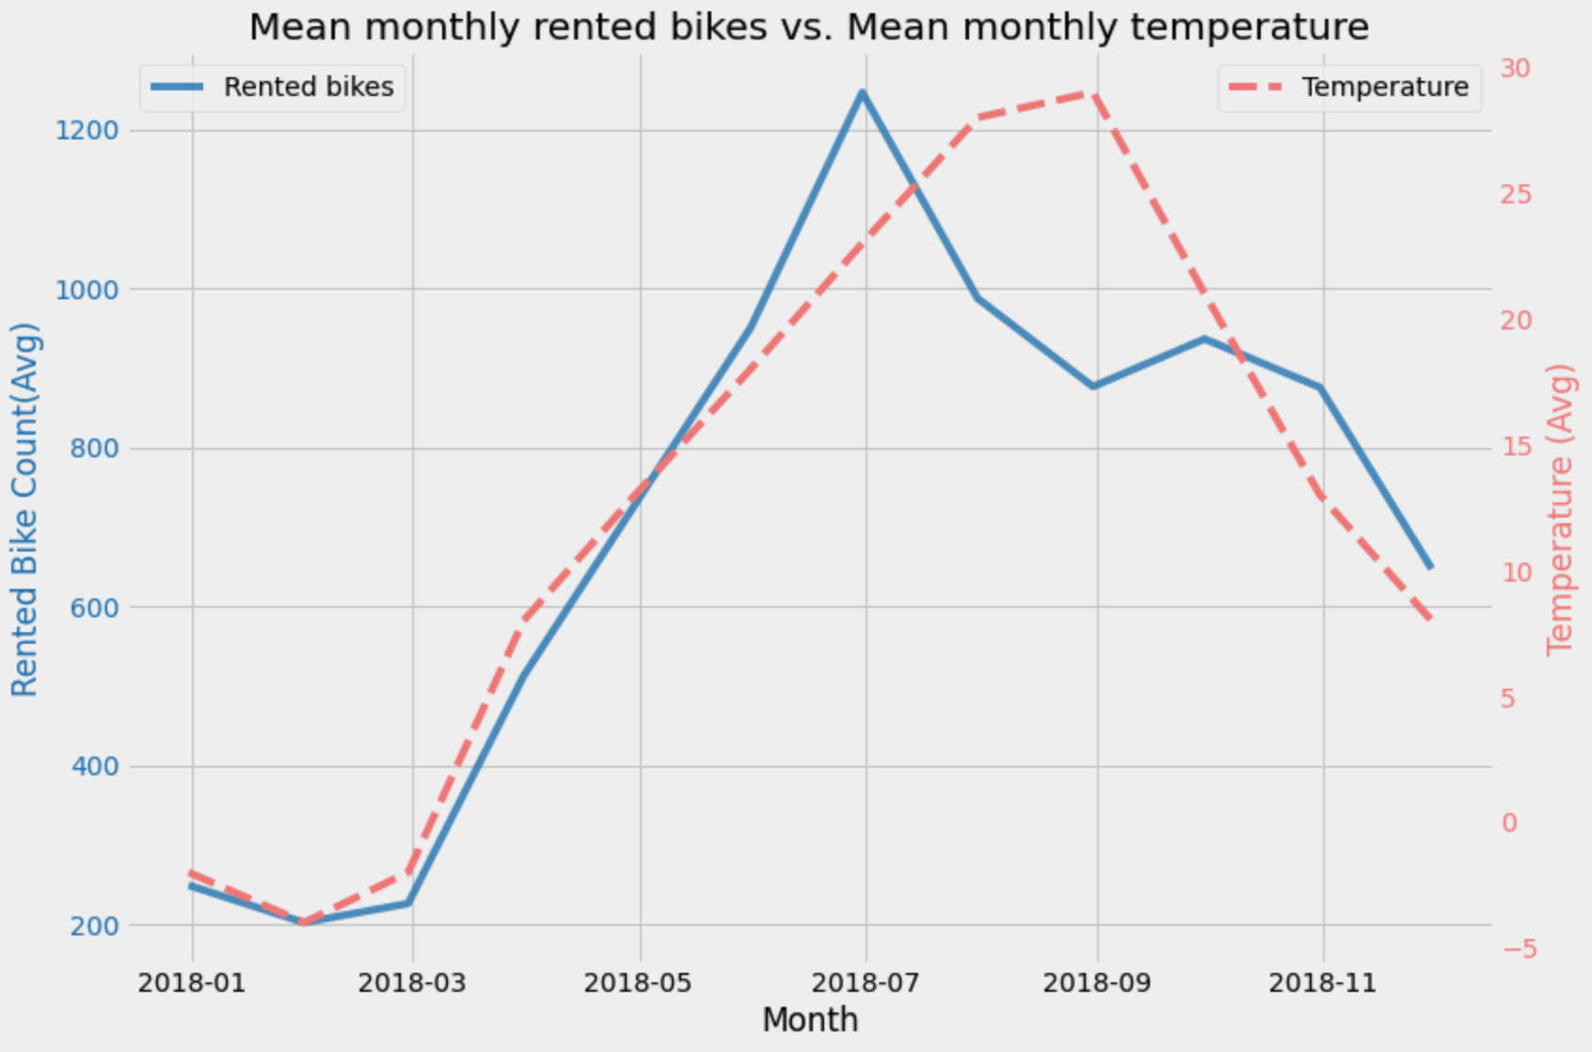
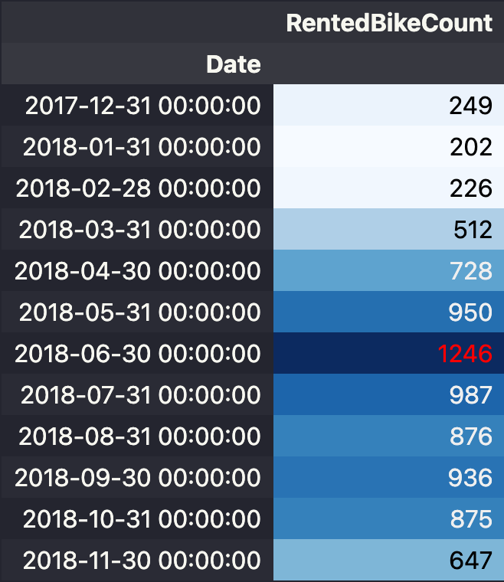
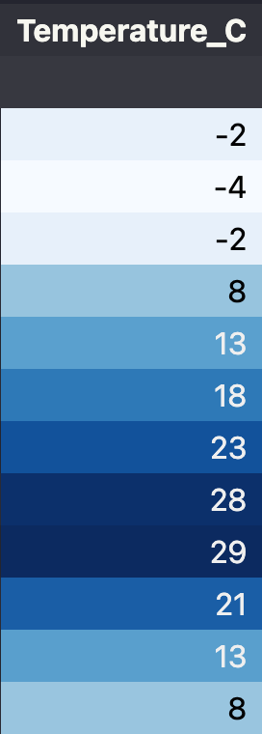

Slide 13
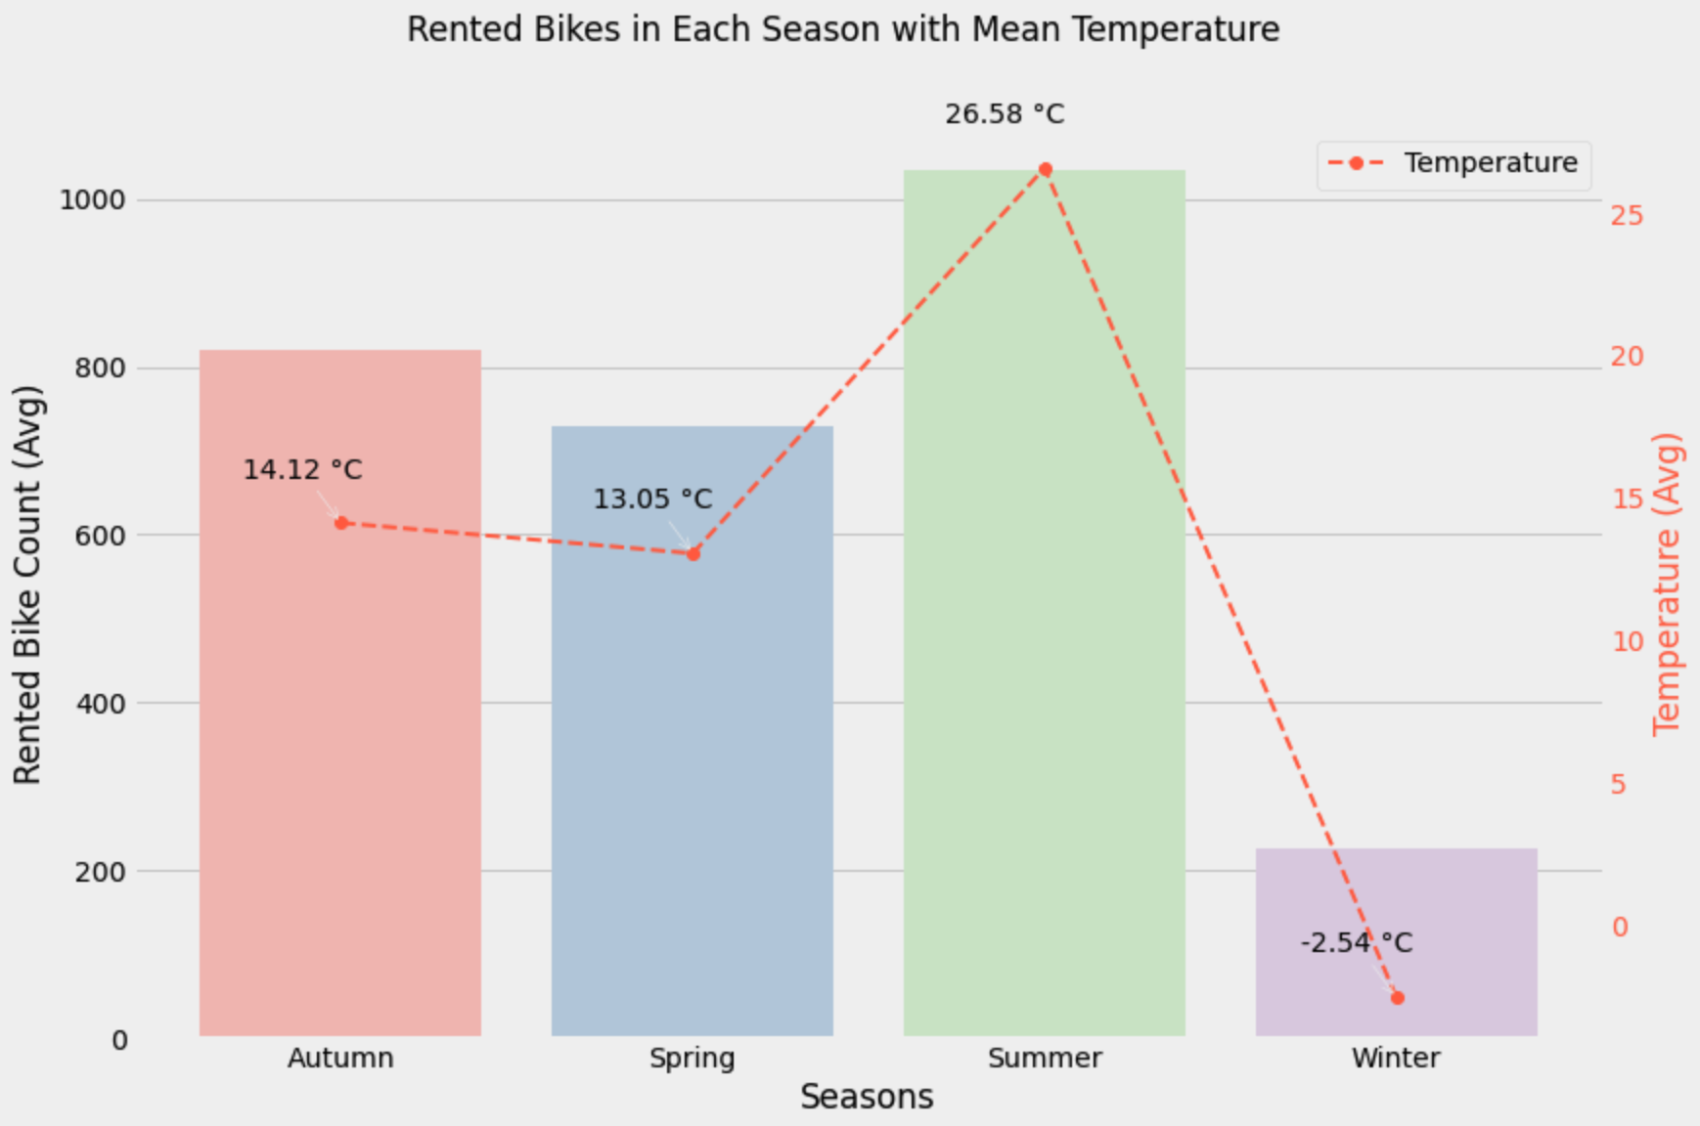
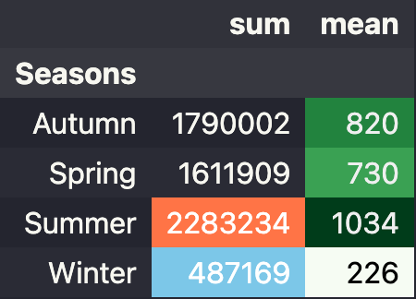

Slide 14
Featuring Engineering
Let’s change some features!

Slide 15
Category Encoding
HourOfTheDay
Seasons
month
Holiday → (-1 , 1)
FunctioningDay → (0 , 1)
❌ One-hot Encoding
✅ Target Encoding

Slide 16
Machine Learning
Modeling, tuning, and prediction.

Slide 17
ML Methods
Linear Regression
Random Forest
Adaboost
*LinearSVR
LightGBM
Random Search
&
Grid Search

Slide 18
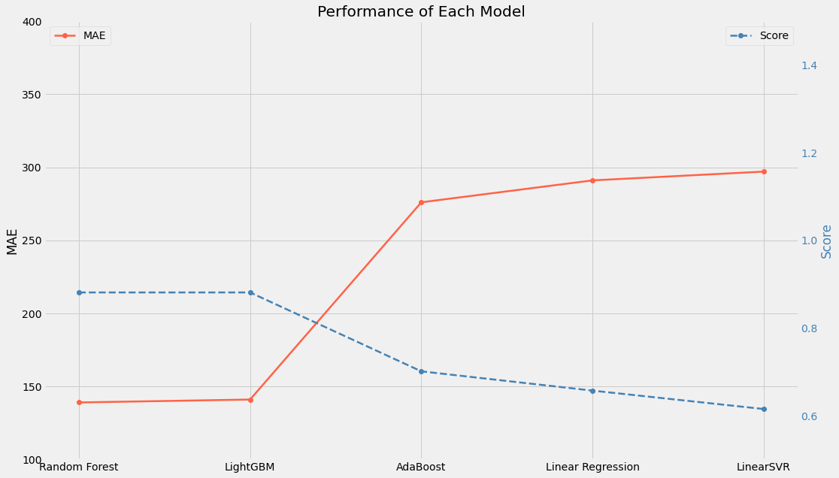

Slide 19
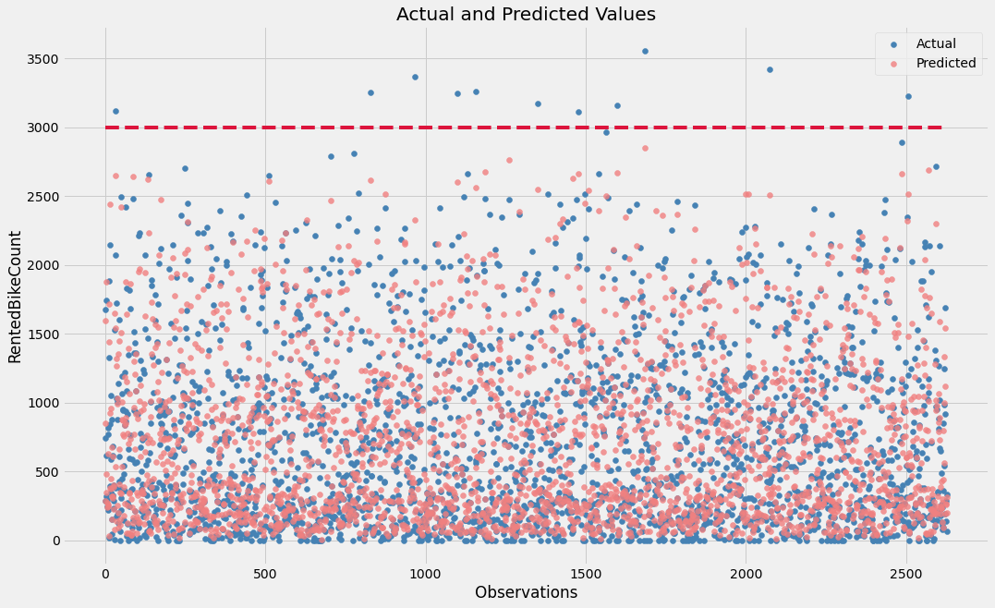

Slide 20
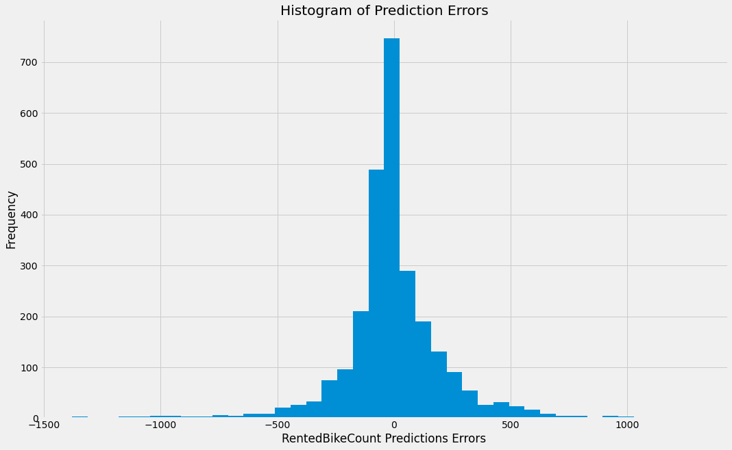

Slide 21
Conclusion
EDA & domain experts
👑 Random Forest
Time-series data

Slide 22
Thanks For Watching
You can find my work on my Github.

